Slide 1
Lesson 9

Slide 2
1
Grammar
02
Listening
Table of content:
- Past simple
- Past perfect
- Past continuous
Part 2: Questions and responses (1)

Slide 3
01
Grammar
Past simple
Past perfect
Past continuous

Slide 4
Past simple
a) Form
Affirmative: (+) Subject + was/ were + N/ adj/ name, age, preprosition+place * Subject + V(ed/ irregular V) + O.
Negative: (-) Subject + wasn’t/ weren’t + N/ adj.
* Subject + didn’t + V (infinitive without to) + O.
Interrogative: (?) Was/ were + Subject + N/adj?
* Did + Subject + V (infinitive without to) + O?
Some common irregular verbs with their past tenses:
Go- went, take-took, get-got, see-saw, buy- bought, have-had, eat-ate,…..

Slide 5
Past simple
b) Usage
We use the past tense to talk about:
Something that happened once in the past:
Something that happened again and again in the past:
- Something that was true for some time in the past:
- I met my wife in 1983.
- We went to Spain for our holidays..
- When I was a boy I walked a mile to school every day.
- We swam a lot while we were on holiday.
- I lived abroad for ten years.
- He enjoyed being a student.

Slide 6
c) Signal words
- Yesterday - Last night/ last week/ last month/ last year, last Monday….. - (2 years)….ago
- In …(2000, 2004…)

Slide 7
Past continuous
a) Form
Affirmative:
(+) Subject + was/ were + Ving. Negative:
(-) Subject + wasn’t/ weren’t + Ving.
Interrogative:
(?) Was/ were + Subject + Ving?

Slide 8
Past continuous
b) Usage
- It describes what was happening at a precise time in the past. Ex: I was eating dinner at 6 o’clock yesterday.
- When we want to talk about an action that was happening over a period of time in the past. Ex: At this time last week, I was lying on the beach in Florida.
- Parallel actions: we can use this tense to describe TWO actions that were BOTH continuing at the same time in the past. Ex: While I was sleeping, she was working.

Slide 9
Past continuous
b) Usage
It can also be used to describe something that was happening continuously in the past when another action interrupted it.
Ex: I was making dinner when she arrived.
The audience was applauding until he fell off the stage.
Fall off

Slide 10
Past perfect
a) Form
Affirmative:
(+) Subject + had + P2. Negative:
(-) Subject + hadn’t + P2.
Interrogative:
(?) Had + Subject + P2?

Slide 11
Past perfect
b) Usage
It is used to make it clear that one event happened before another in the past.
Ex: When I got home yesterday, my father had already cooked dinner.
I didn't want to go to the movies with my friends because I had seen the film already.

Slide 12
PRACTICE

Slide 13
Exercise 1. Choose the correct answer
1. They __________ the bus yesterday.
A. don’t catch B. weren’t catch C. didn’t catch D. not catch
2. My sister __________ home late last night.
comes B. come C. came D. was come
3. My father __________ tired when I __________ home.
A. was – got B. is – get C. was – getted D. were – got
4. What __________ you __________ two days ago?
A. do – do B. did – did C. do – did D. did – do
5. Where __________ your family __________ on the summer holiday last year?
A. do – go B. does – go C. did – go D. did – went

Slide 14
Exercise 2. Choose the correct answer. 1. I heard a knock at the front door so I (went / was going) to answer it. 2. At this time yesterday, I (wrote / was writing) an essay. 3. The football season (began / was beginning) a month ago. 4. She (had graduated / graduated) from school in 2001. 5. We entered the house quietly because everyone (was sleeping / had slept). 6. By the time we (got / had got) to the cinema, the film had already started. 7. The children (were playing / played) in the garden while their parents were watching them. 8. They (had left / left) many hours before we arrived

Slide 15
Exercise 3. Simple Past or Present Perfect? 1) Peter ____________football yesterday. (play) 2) They ______________ the car. It looks new again. (wash) 3) Last year we ________ to Italy. (go) 4) John and Peggy ____________ the book. Now they can watch the film. (read) 5) I ________ my friends two days ago. (meet) 6) We___________ to another country before. (be) 7) She __________a new car in 2005. (buy) 8) I'm sorry, but I _________________ my homework. (not, do) 9) ________ you _____________ the game of chess? (ever, play) 10) The girls ______________ their lunch yet. (not, have)
played
have washed
went
have read
met
have been
bought
haven’t done
Have ever played
haven’t had

Slide 16
Exercise 4. Complete the sentences with the correct form of the verbs in brackets. Use the Past Simple, Past Continuous or Past Perfect. 1. They .................................... (get) to the airport as the plane was landing. 2. She wore the shoes she ..................................... (buy) the previous day. 3. I fell as I .................................... (run) for the bus.
4. What ...................... she ..................... (say) when he asked her to marry him?
5. When I was a student, I .................................... (not have) much money.
6. Why .................... she still ........................ (work) at one o’clock in the morning?
7. I was happy to see her, because we ........................ (not see) each other for years.
8. By the time we got to the shop, a long queue .............. already .............. (form) outside
got
had bought
was running
did say
didn’t have
was working
hadn’t seen
had formed

Slide 17
LISTENING

Slide 18
TOEIC LISTENING part 2:
Questions & responses
In each question, you will listen to a question and then listen to 3 possible responses. Choose the correct response.

Slide 19
Track 11
Track 12
Track 13
1. A B C
2. A B C
3. A B C
4. A B C
5. A B C

Slide 20
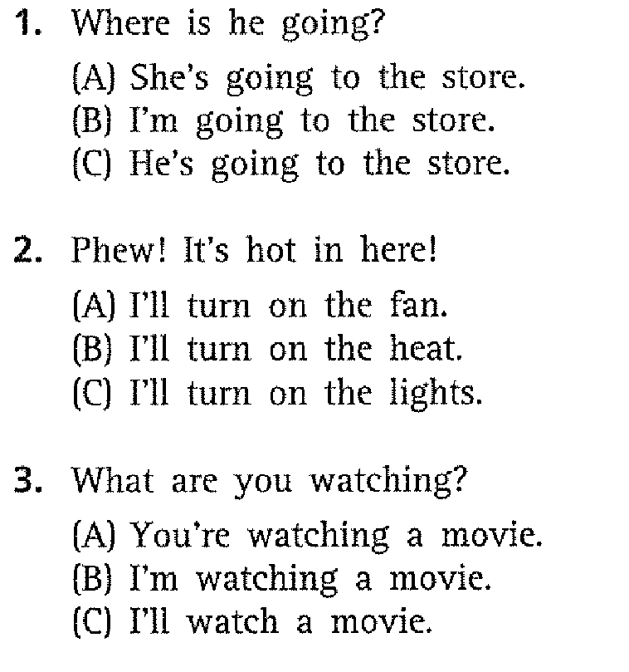
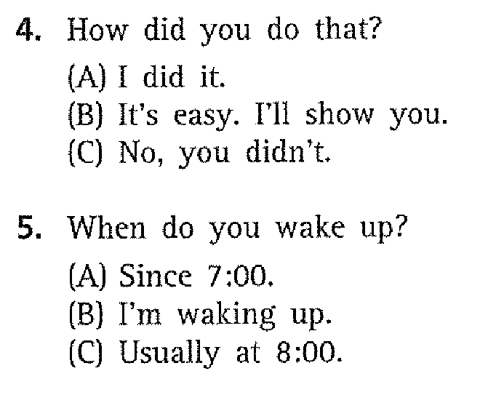
Track 11

Slide 21
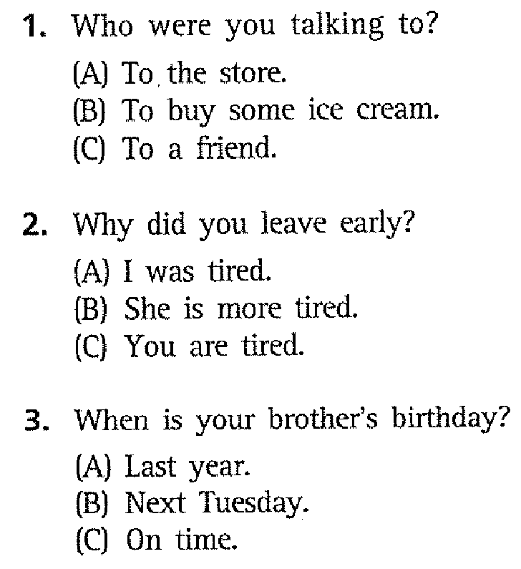
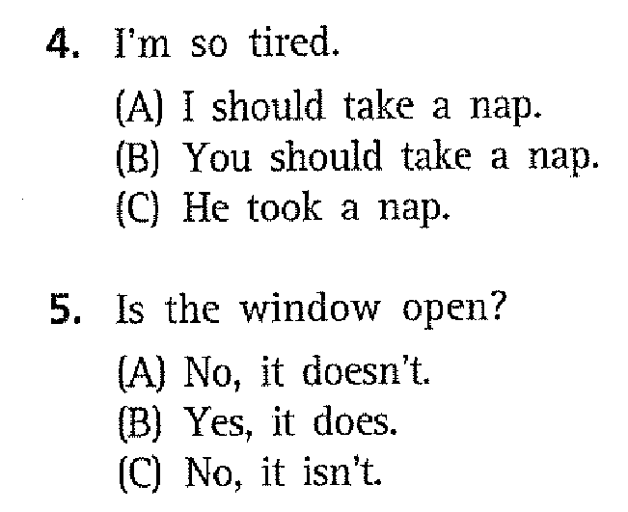
Track 12

Slide 22
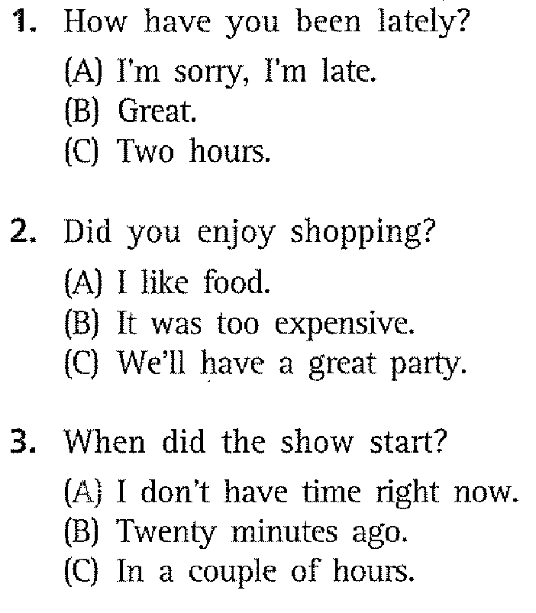
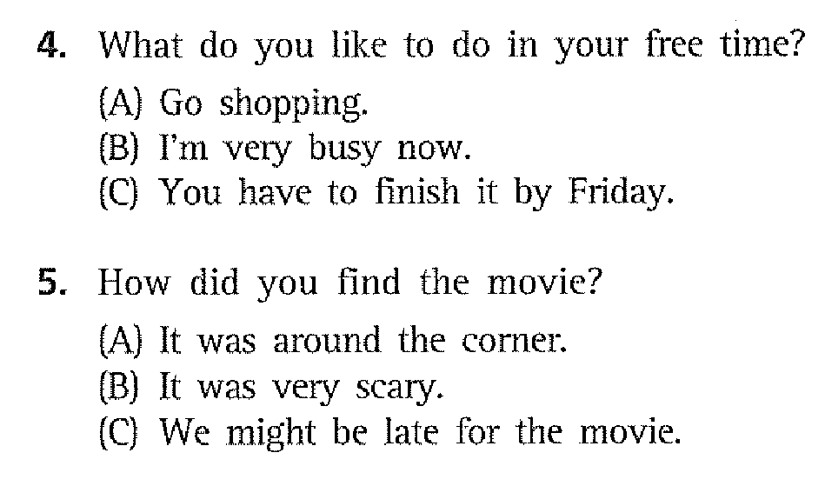
Track 13

